Slide 1
Employee Record Management System
SIC-25-26-Team144

Slide 2
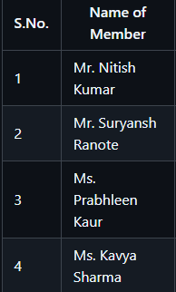
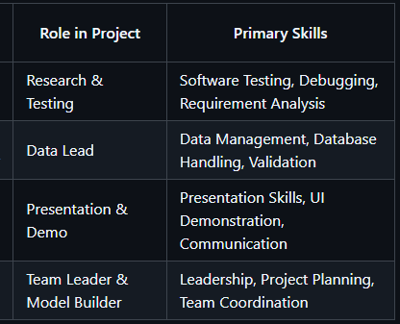
Employee Record Management System
About our Team
Team Name: SIC-25-26-Team144
Project Title : Employee Record Management System
Course: SIC Coding & Programming
Rayat-Bahra University (B-25038)

Slide 3
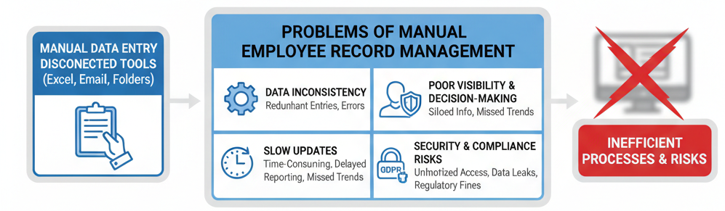
Employee Record Management System
Problem Statement
HR teams, managers, and organizations struggle to efficiently store, update, search, and analyze employee data in one centralized system.

Slide 4
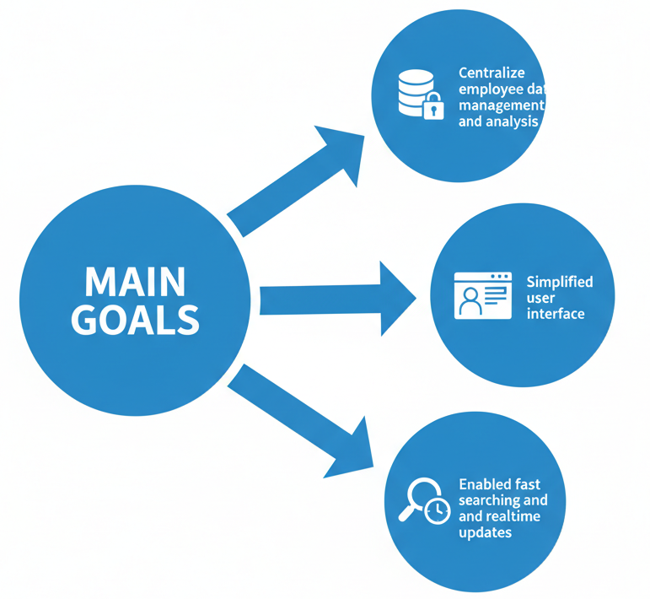
Employee Record Management System
Objective of the Project
Expected Outcome
A fully functional desktop application for employee management
Accurate data handling with instant CRUD operations
Dynamic SQL query execution for advanced insights

Slide 5
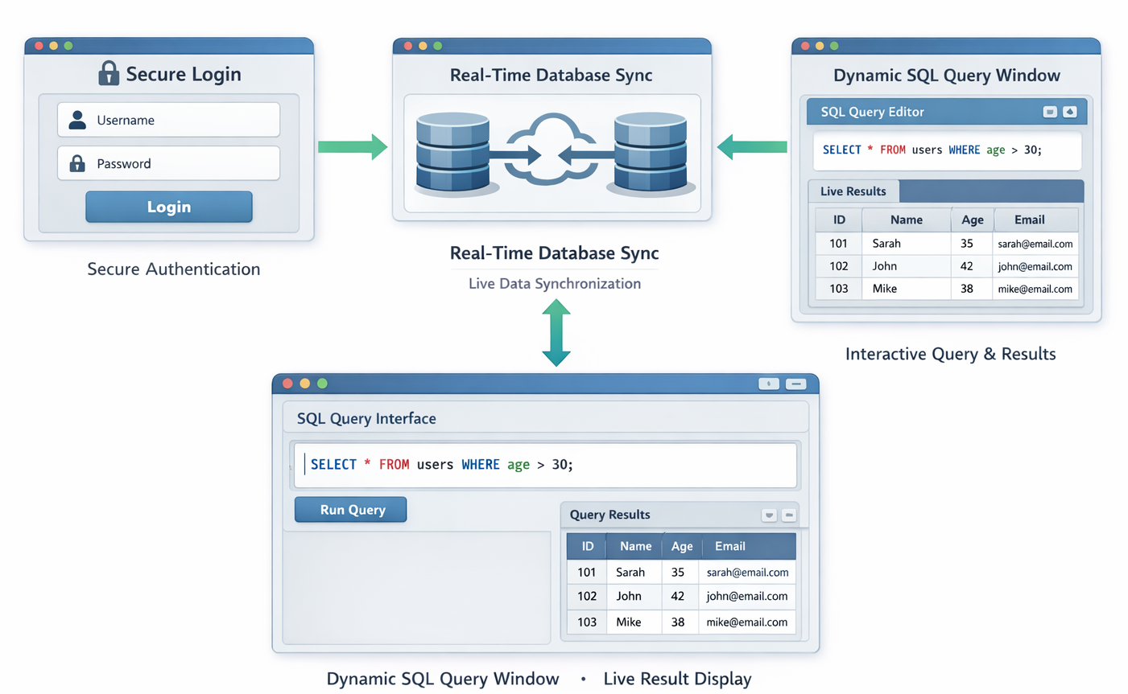
Employee Record Management System
Proposed Solution
We’ve built a desktop-based Employee Management System using Python and MySQL that allows users to log in securely, manage employee records, and run live SQL queries through an interactive interface.

Slide 6
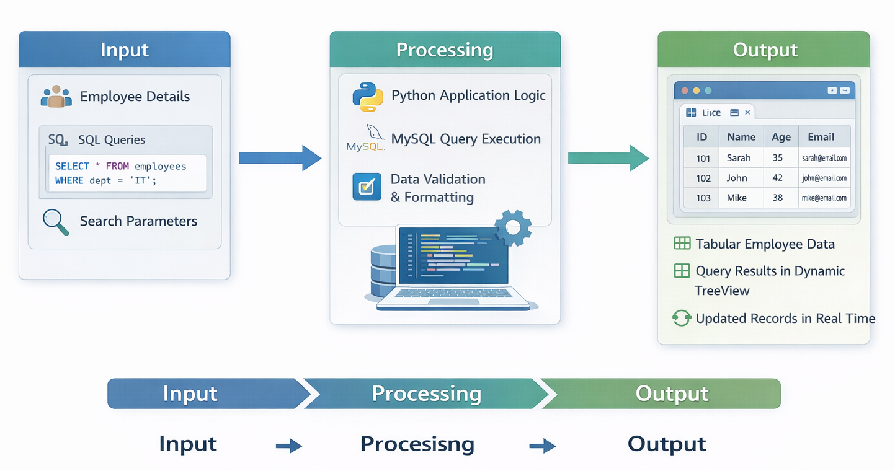
Employee Record Management System
System Architecture / Flow Diagram

Slide 7






Employee Record Management System
Tools, Technologies & Libraries
Programming Language: Python
Libraries: CustomTkinter, Tkinter, PyMySQL, PIL (Image Handling)
Tools: VS Code, MySQL Server, GitHub, Jupyter (testing & planning)
Database: MySQL (Custom schema)

Slide 8
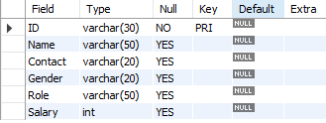
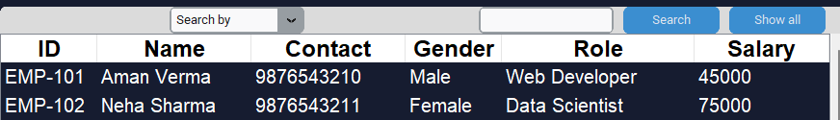
Employee Record Management System
Dataset Description
Dataset Type
Custom real-time employee database
Data Cleaning
Mandatory field validation
Unique ID enforcement
Format checks for employee IDs

Slide 9
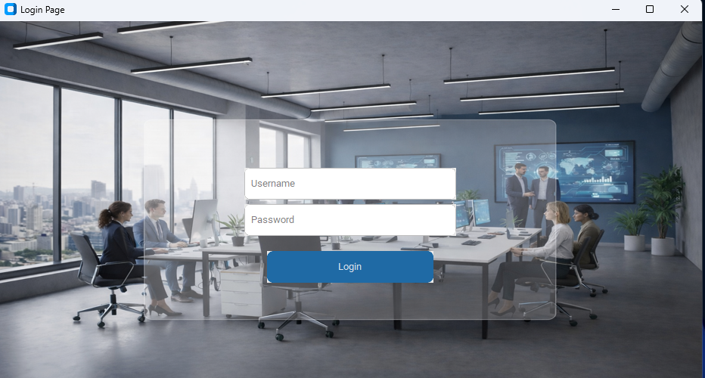
Employee Record Management System
Project Screenshots / Project Designs
LOGIN PAGE UI

Slide 10
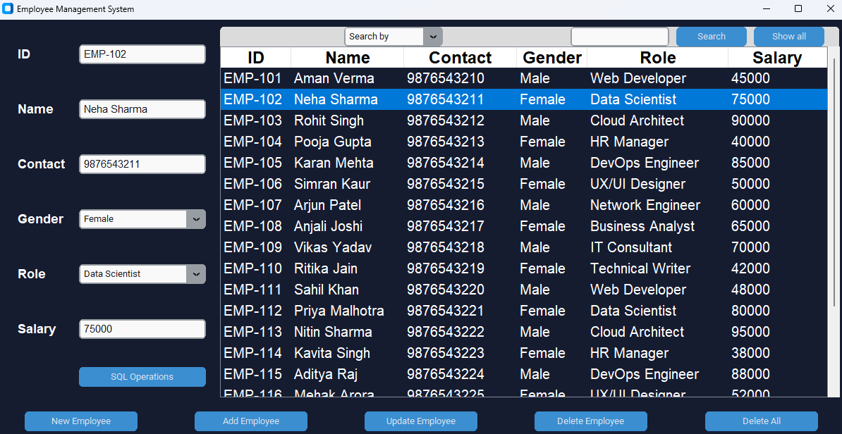
Employee Record Management System
Project Screenshots / Project Designs
CRUD operations on Employee details UI

Slide 11
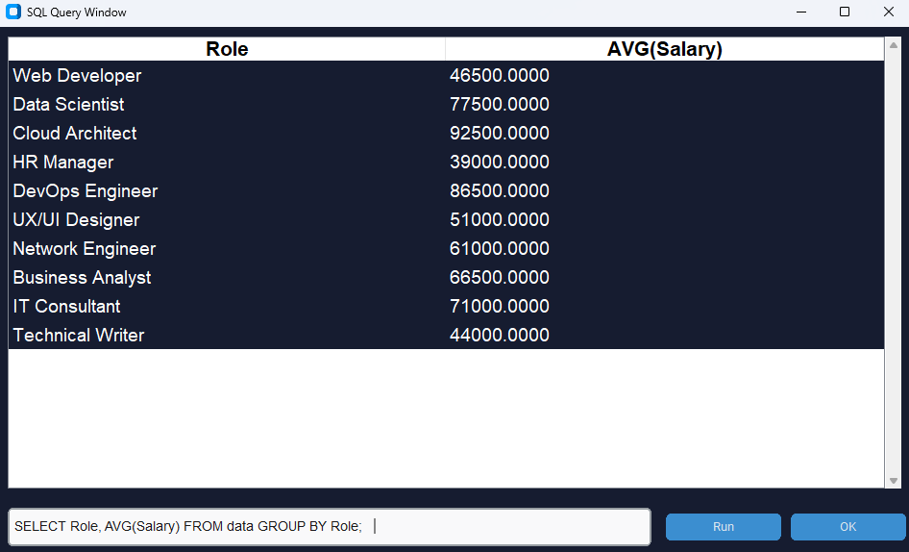
Employee Record Management System
Project Screenshots / Project Designs
SQL QUERY WINDOW UI

Slide 12
Employee Record Management System
Results & Performance
Key Results
Successfully implemented full CRUD operations
Live database interaction with instant updates
Flexible SQL query execution for advanced analysis
Challenges Faced
Dynamic TreeView column rendering
Managing database synchronization
Error handling for custom SQL queries
Future Scope
Role-based authentication
Cloud database integration
Data analytics & visualization
Web and mobile version deployment

Slide 13

Thank You
Open for questions
Samsung Innovation Campus

